Slide 1

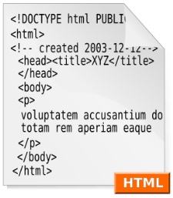



HTTP and AJAX
WWW, HTTP, AJAX, JSONP
Nikolay Kostov
Senior Software Developer and Trainer
http://nikolay.it
Telerik Software Academy

Slide 2

Table of Contents
WWW and URL
HTML, XML, JSON, RSS, JSONP
The HTTP Protocol
HTTP Request
HTTP Response
AJAX Requests
Same-Origin Policy
Workarounds
JSONP
Web Developer Tools

Slide 3



WWW and URL
What is WWW? What is URL?

Slide 4
What is WWW?
WWW = World Wide Web = Web
Global distributed information system in Internet
A service in Internet (like E-mail, DNS, ...)
Consists of set of documents (and other resources) located on different Internet servers
Accessed through standard protocols like HTTP, HTTPS and FTP by their URL
Web servers provide Web content
Web browsers display the Web content

Slide 5
WWW Components
Structural components
Internet – provides data transfer channels over the TCP and HTTP protocols
Clients (Web browsers) – display Web content
Web servers – IIS, Apache, Tomcat, GWS, etc.
Semantic components
Hyper Text Transfer Protocol (HTTP)
Hyper Text Markup Language (HTML)
Uniform Resource Locator (URL)
Uniform Resource Identifiers (URIs)

Slide 6
WWW Infrastructure
Clients use Web browser application to request resources from the Web servers via HTTP
Resources have unique URL address
Servers send the requested resource as a response
Or reply with an error message
Web pages are resources in WWW
HTML text, graphics, animations and other files
Web sites
Web sites are sets of Web pages in WWW

Slide 7
WWW Infrastructure (2)
Client’s browser renders Web pages returned by the Web servers
Pages are in HTML (Hyper Text Markup Language)
Browsers shows the text, graphics, sounds, etc.
HTML pages contain hyperlinks to other pages
The entire WWW system runs over standard networking protocols
TCP, DNS, HTTP, FTP, …
The HTTP protocol is fundamental for WWW

Slide 8
URL
Uniform Resource Locator (URL)
Unique resource location in WWW, e.g.
It is just a formatted string, consisting of:
Protocol for communicating with the server (e.g., http, ftp, https, ...)
Name of the server or IP address + optional port (e.g. www.telerik.com, mail.bg:8080)
Path and name of the resource (e.g. index.php)
Parameters (optional, e.g. ?id=27&lang=en)
http://yoursite.com:8080/path/index.php?id=27&lang=en

Slide 9
URL Encoding
URLs are encoded according RFC 1738:
All other characters are escaped with the formula:
Example: space has decimal code 32, in hex – 20, so space in URL becomes %20
Space can also be encoded as "+"
“... Only alphanumeric [0-9a-zA-Z], the special characters $-_.+!*'() and reserved characters used for their reserved purposes may be used unencoded within an URL.”
%[character hex code in ISO-Latin character set]

Slide 10
URL – Examples
Some valid URLs:
Some invalid URLs:
http://www.google.bg/search?sourceid=navclient&ie=UTF-8&rlz=1T4GGLL_enBG369BG369&q=http+get+vs+post
http://bg.wikipedia.org:80/wiki/%D0%A2%D0%B5%D0%BB%D0%B5%D1%80%D0%B8%D0%B3
Should be: ?q=C%23+.NET+4.0
http://www.google.bg/search?&q=C# .NET 4.0
Should be: ?q=%D0%B1%D0%B8%D1%80%D0%B0
http://www.google.bg/search?&q=бира

Slide 11

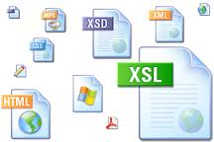

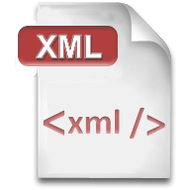




HTML, XML, JSON, RSS
Comparing the Common Web Data Formats

Slide 12
HTML
Hyper Text Markup Language (HTML)
Notation for describing formatted text with images and hyperlinks
Interpreted and displayed by the Web browsers
A Web (HTML) page consists of:
HTML file
CSS stylesheet file (optional)
A bunch of images (optional)
Other resources (optional)

Slide 13
HTML
HTML is straight-forward and easy to learn
HTML documents are plain text files
Easy to add formatting, hyperlinks, bullets, etc.
Images can be added as separate files
Can be automatically generated by authoring programs
Tools to help users creating HTML pages
E.g. FrontPage, Dreamweaver, Visual Studio
WYSIWYG HTML editors

Slide 14
HTML – Example
<html>
<head><title>HTML Example</title></head>
<body>
<h1>Heading 1</h1>
<h2>Sub heading 2</h2>
<h3>Sub heading 3</h3>
<p>This is my first paragraph</p>
<p>This is my second paragraph</p>
<div align="center"
style="background:skyblue">
This is a div</div>
</body>
</html>

Slide 15

XML
XML is markup-language for encoding documents in machine-readable form
Text-based format
Consists of tags, attributes and content
Provide data and meta-data in the same time
<?xml version="1.0"?>
<library>
<book><title>HTML 5</title><author>Bay Ivan</author></book>
<book><title>WPF 4</title><author>Microsoft</author></book>
<book><title>WCF 4</title><author>Kaka Mara</author></book>
<book><title>UML 2.0</title><author>Bay Ali</author></book>
</library>

Slide 16

RSS
RSS (Really Simple Syndication)
Family of Web feed formats for publishing frequently updated works
E.g. blog entries, news headlines, videos, etc.
Based on XML, with standardized XSD schema
RSS documents (feeds) are list of items
Each containing title, author, publish date, summarized text, and metadata
Atom protocol aimed to enhance / replace RSS

Slide 17
RSS – Example
<?xml version="1.0" encoding="utf-8" ?>
<rss version="2.0">
<channel>
<title>W3Schools Home Page</title>
<link>http://www.w3schools.com</link>
<description>Free web building tutorials</description>
<item>
<title>RSS Tutorial</title>
<link>http://www.w3schools.com/rss</link>
<description>New RSS tutorial on W3Schools</description>
</item>
<item>
<title>XML Tutorial</title>
<link>http://www.w3schools.com/xml</link>
<description>New XML tutorial on W3Schools</description>
</item>
</channel>
</rss>

Slide 18
JSON
JSON (JavaScript Object Notation)
Standard for representing simple data structures and associative arrays
Lightweight text-based open standard
Derived from the JavaScript language
{
"firstName": "John", "lastName": "Smith", "age": 25,
"address": { "streetAddress": "33 Alex. Malinov Blvd.",
"city": "Sofia", "postalCode": "10021" },
"phoneNumber": [{ "type": "home", "number": "212 555-1234"},
{ "type": "fax", "number": "646 555-4567" }]
},
{ "firstName": "Bay", "lastName": "Ivan", "age": 79 }

Slide 19


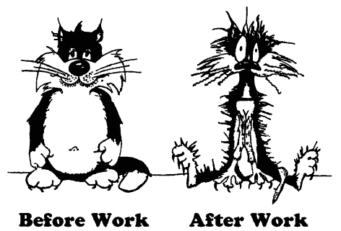
The HTTP Protocol
How HTTP Works?
HTTP

Slide 20
HTTP
Hyper Text Transfer Protocol (HTTP)
Client-server protocol for transferring Web resources (HTML files, images, styles, etc.)
Important properties of HTTP
Request-response model
Text-based format
Relies on unique resource URLs
Provides resource metadata (e.g. encoding)
Stateless (cookies can overcome this)

Slide 21
HTTP: Request-Response Protocol
Client program
Running on end host
E.g. Web browser
Requests a resource
Server program
Running at the server
E.g. Web server
Provides resources
GET /index.html
HTTP/1.0
HTTP/1.0 200 OK
"Welcome to our
Web site!"
21

Slide 22
Example: Hyper Text Transfer Protocol
HTTP request:
GET /academy/about.aspx HTTP/1.1
Host: www.telerik.com
User-Agent: Mozilla/5.0
<CRLF>
The empty line denotes the end of the request header
HTTP response:
HTTP/1.1 200 OK
Date: Mon, 5 Jul 2010 13:09:03 GMT
Server: Microsoft-HTTPAPI/2.0
Last-Modified: Mon, 12 Jul 2010 15:33:23 GMT
Content-Length: 54
<CRLF>
<html><title>Hello</title>
Welcome to our site</html>
The empty line denotes the end of the response header

Slide 23
HTTP Request Message
Request message sent by a client consists of
Request line – request method (GET, POST, HEAD, ...), resource URI, and protocol version
Request headers – additional parameters
Body – optional data
E.g. posted form data, files, etc.
<request method> <resource> HTTP/<version>
<headers>
<empty line>
<body>

Slide 24
HTTP GET Request – Example
Example of HTTP GET request:
GET /academy/winter-2009-2010.aspx HTTP/1.1
Host: www.telerik.com
Accept: */*
Accept-Language: bg
Accept-Encoding: gzip, deflate
User-Agent: Mozilla/4.0(compatible;MSIE 6.0; Windows NT 5.0)
Connection: Keep-Alive
Cache-Control: no-cache
<CRLF>
HTTP request line
HTTP headers
The request body is empty

Slide 25
HTTP POST Request – Example
Example of HTTP POST request:
POST /webmail/login.phtml HTTP/1.1
Host: www.abv.bg
Accept: */*
Accept-Language: bg
Accept-Encoding: gzip, deflate
User-Agent: Mozilla/4.0(compatible;MSIE 6.0; Windows NT 5.0)
Connection: Keep-Alive
Cache-Control: no-cache
Content-Length: 59
<CRLF>
LOGIN_USER=mente
DOMAIN_NAME=abv.bg
LOGIN_PASS=top*secret!
<CRLF>
HTTP request line
HTTP headers
The request body contains the submitted form data

Slide 26
Conditional HTTP GET – Example
Example of HTTP conditional GET request:
GET /academy/join.aspx HTTP/1.1
Host: www.telerik.com
User-Agent: Gecko/20100115 Firefox/3.6
If-Modified-Since: Tue, 9 Mar 2010 11:12:23 GMT
<CRLF>
Fetches the resource only if it has been changed at the server
Server replies with “304 Not Modified” if the resource has not been changed
Or “200 OK” with the latest version otherwise

Slide 27
HTTP Response Message
Response message sent by the server
Status line – protocol version, status code, status phrase
Response headers – provide meta data
Body – the contents of the response (the requested resource)
HTTP/<version> <status code> <status text>
<headers>
<CRLF>
<response body – the requested resource>

Slide 28
HTTP Response – Example
Example of HTTP response from the Web server:
HTTP response status line
HTTP/1.1 200 OK
Date: Fri, 17 Jul 2010 16:09:18 GMT+2
Server: Apache/2.2.14 (Linux)
Accept-Ranges: bytes
Content-Length: 84
Content-Type: text/html
<CRLF>
<html>
<head><title>Test</title></head>
<body>Test HTML page.</body>
</html>
HTTP response headers
The HTTP response body

Slide 29
HTTP Response – Example
Example of HTTP response with error result:
Response status line
HTTP/1.1 404 Not Found
Date: Fri, 17 Jul 2010 16:09:18 GMT+2
Server: Apache/2.2.14 (Linux)
Connection: close
Content-Type: text/html
<CRLF>
<HTML><HEAD>
<TITLE>404 Not Found</TITLE>
</HEAD><BODY>
<H1>Not Found</H1>
The requested URL /img/telerik-logo.gif was not found on this server.<P>
<HR><ADDRESS>Apache/2.2.14 Server at Port 80</ADDRESS>
</BODY></HTML>
HTTP response headers
The HTTP response body

Slide 30
Content-Type and Disposition
The Content-Type header at the server specifies how the output should be processed
Examples:
UTF-8 encoded HTML page. Will be shown in the browser.
Content-Type: text/html; charset=utf-8
Content-Type: application/pdf
Content-Disposition: attachment;
filename="Financial-Report-April-2010.pdf"
This will download a PDF file named Financial-Report-April-2010.pdf

Slide 31
HTTP Request Methods
HTTP request methods:
GET
Return the specified resource, run a program at the server, or just download file, …
HEAD
Return the meta-data associated with a resource (headers only)
POST
Update a resource, provide input data for processing at the server, …

Slide 32
HTTP Response Codes
HTTP response code classes
1xx: informational (e.g., “100 Continue”)
2xx: success (e.g., “200 OK”)
3xx: redirection (e.g., “304 Not Modified”, "302 Found")
4xx: client error (e.g., “404 Not Found”)
5xx: server error (e.g., “503 Service Unavailable”)
"302 Found" is used for redirecting the Web browser to another URL

Slide 33
Browser Redirection
HTTP browser redirection example
HTTP GET requesting a moved URL:
The HTTP response says the browser should request another URL:
GET / HTTP/1.1
Host: academy.telerik.com
User-Agent: Gecko/20100115 Firefox/3.6
<CRLF>
HTTP/1.1 301 Moved Permanently
Location: http://www.telerik.com/academy/
…

Slide 34
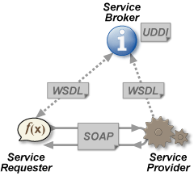
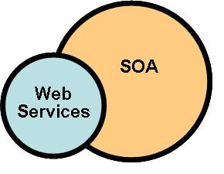
Web Services
Web Services and SOA Architecture

Slide 35
Web Services
A web service is a method of communication between two devices in WWW
The server device exposes services
The client consumes these services
Web services are a main part of the SOA architecture
Database and Business logic on the server
The server exposes public services
UI logic on the client
Consumes these services

Slide 36
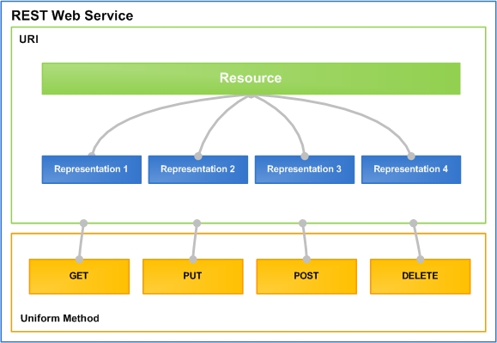
RESTful Web Services
Lightweight Architecture for Web Services

Slide 37
What is REST?
"Representational state transfer (REST) is a style of software architecture for distributed hypermedia systems such as the World Wide Web."
http://en.wikipedia.org/wiki/Representational_State_Transfer
Application state and functionality are resources
Resources are used as common data files
Every resource has an URI
All resources share a uniform interface
This natively maps to the HTTP protocol

Slide 38
RESTful Services
One URI for a resource, multiple operations
Add a new document "RestTalk" in category "Code"
PUT http://mysite.com/docs/Code/RestTalk
Get the document / some page
GET http://mysite.com/docs/Code/RestTalk
GET http://mysite.com/docs/Code/RestTalk/pages/3
Remove the document
DELETE http://mysite.com/docs/Code/RestTalk
Retrieve metadata
HEAD http://mysite.com/docs/Code/RestTalk

Slide 39



AJAX
Asynchronous JavaScript and XML

Slide 40
AJAX
AJAX is acronym of Asynchronous JavaScript and XML
Technique for background loading of dynamic content and data from the server side
Allows dynamic client-side changes
Two styles of AJAX
Partial page rendering – loading of HTML fragment and showing it in a <div> (AHAH)
JSON service – loading JSON object and client-side processing it with JavaScript / jQuery

Slide 41
AJAX
Technically, AJAX is a group of technologies working together
HTML & CSS for presentation
The DOM for data display & interaction
XML (or JSON) for data interchange
XMLHttpRequest for async communication
JavaScript to use the above

Slide 42
AJAX
AJAX uses HTTP
Requests have headers – GET, POST, HEAD, etc.
Requests have bodies – XML, JSON or plain text
The request must target a resource with a URI
The resource must understand the request
Server-side logic
Requests get a HTTP Response
Header with a body

Slide 43
The Same Origin Policy
i.e. Don't talk to strangers

Slide 44
Same Origin Policy
Security concept for browser-side programming languages
Scripts running on pages from the same site
i.e. the same origin
Can access each other without restriction
Scripts cannot access pages on different sites
This also applies to XMLHttpRequest
Sent only between pages with same origin

Slide 45
Origin Determination Rules
Origin is defined using
Domain name (e.g. example.com)
Application layer protocol (e.g. http)
Port number (not all browsers!)
Two resources are of the same origin if all of the above match

Slide 46
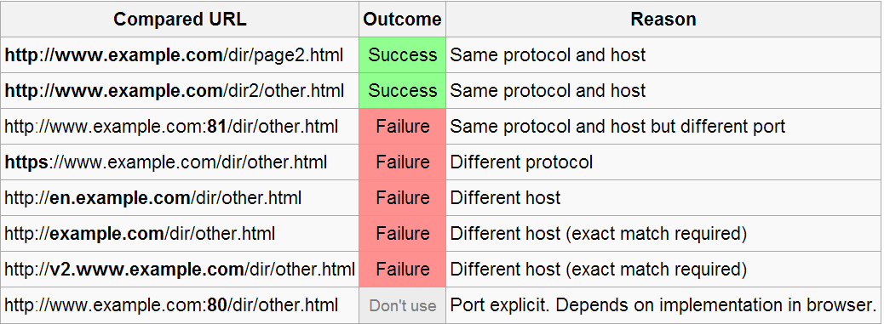
Origin Determination Example
Say we have a resource at http://www.example.com/dir/page.html
The following table shows outcomes of origin checks with resources at similar URLs

Slide 47
Relaxing Same Origin Policy
Same origin policy is sometimes too restrictive
Large sites with lots of subdomains
Accessing web services
Ways of "relaxing"
document.domain – can be set to a superdomain when in proper subdomain
Cross document messaging – HTML5, postMessage() to page in <iframe>
Cross Origin Resource Sharing
Workaround – JSONP

Slide 48
JSONP
i.e. not listening to mommy

Slide 49
JSONP
JSON with padding (also JSON prefix)
Same origin policy denies cross-origin requests
But not for the <script> tag
The <script> tag can be exploited
Retrieve JS code and the browser executes it
In the case of a service, we get a JSON object
The script tag can have a callback
We receive parseResponse(…)
<script type="text/javascript"
src="http://server2.example.com/Users/1234?
jsonp=parseResponse"></script>

Slide 50
JSONP – How it Works
After the script URL, we add a query parameter ?jsonp= (or ?callback=)
This parameter tells the server what to return
The server wraps its return value in the specified callback
Example
server returns a JSON object {"age":"5"}
the query parameter is ?callback=parseResponse
The browser executes the following JS code:
parseResponse({"age":"5"})

Slide 51
JSONP – the "Padding"
The callback function in the example is called the "padding"
Typically its used to pass the JSON to a function, which acts as a handler, but it can be anything else
Variable assignment, if statement, etc.
What we receive is JS code, not JSON
This is a security concern

Slide 52
Web Developer Tools
Simulating and Tracking Web Traffic

Slide 53


Web Developer Tools
Firebug plug-in for Firefox
A must have for Web developers
The ultimate tool for monitoring, editing and debugging HTTP, HTML, CSS, JavaScript, etc.
Free, open-source – www.getfirebug.com
Fiddler – HTTP proxy
Intercepts the HTTP traffic
Analyzes the HTTP conversation
Free tool (by Telerik) – www.fiddler2.com

Slide 54

Web Developer Tools (2)
Wireshark packet analyzer
Low-level packet sniffer
Intercepts the entire IP network traffic
Can reconstruct the HTTP conversation
Can intercept any (unencrypted) protocol
IP, ICMP, TCP, UDP, HTTP, DNS, SMTP, POP3
Can intercept passwords sent in clear-text
Free, open-source project – www.wireshark.org

Slide 55
Web Technologies Basics
http://schoolacademy.telerik.com

Slide 56




Free Trainings @ Telerik Academy
“C# Programming @ Telerik Academy
csharpfundamentals.telerik.com
Telerik Software Academy
academy.telerik.com
Telerik Academy @ Facebook
facebook.com/TelerikAcademy
Telerik Software Academy Forums
forums.academy.telerik.com

